Slide 1
Chapter 2: The Relational Model
Notes:
关系数据模型因为其简单有效而在数据库领域占据主导地位。讲授关系模型的数学模型，包括关系模型的数据结构、数据完整性、数据操作；重点讲授关系代数及基本关系操作及附加关系操作，学习用关系代数表达式表达数据查询要求。

Slide 2

Attributes属性
(or columns)
Tuples元组
(or rows)
关系型数据库是一系列表的集合
一张表是一个基本单位
表中的一行表示一条关系

Slide 3
Basic Structure
relation r : D₁ x D₂ x … x D_{n.}
一条relation 就是一个n元的元组 (a₁, a₂, …, a_{n})

Slide 4
Relation Schema and Instance
A₁, A₂, …, A_{n} are attributes 属性（列名）
R = (A₁, A₂, …, A_{n} ) is a relation schema关系模式（是对关系的抽象)
relation instance r (R)表示关系模式R中的一种关系。不过经常用相同的名字命名关系模式和关系
domain attribute的值域
Attribute values 必须是atomic（原子的）， 即不可分
The special value null （空值） is a member of every domain 属于任何
关系中的行和列的顺序irrelevant ，关系无序
Notes:
1

Slide 5
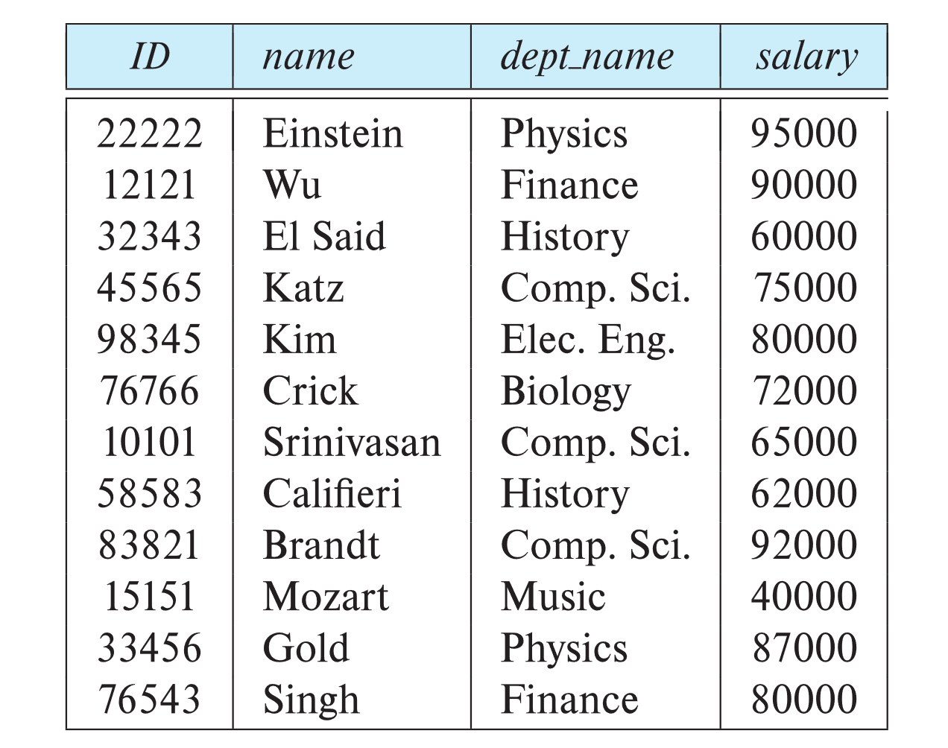
Database Schema
Database schema -- is the logical structure of the database.
Database instance实例 -- is a snapshot of the data in the database at a given instant in time.

Slide 6
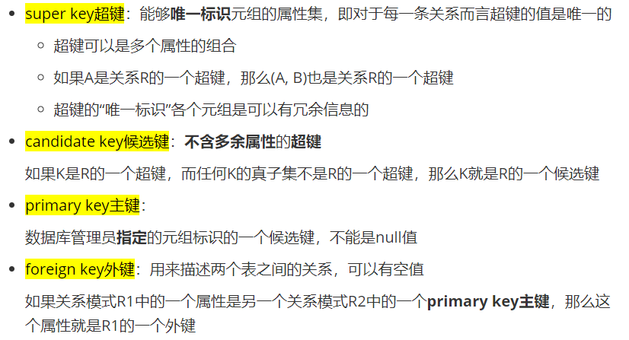
Keys
如果插入时查无此值，会拒绝插入

Slide 7
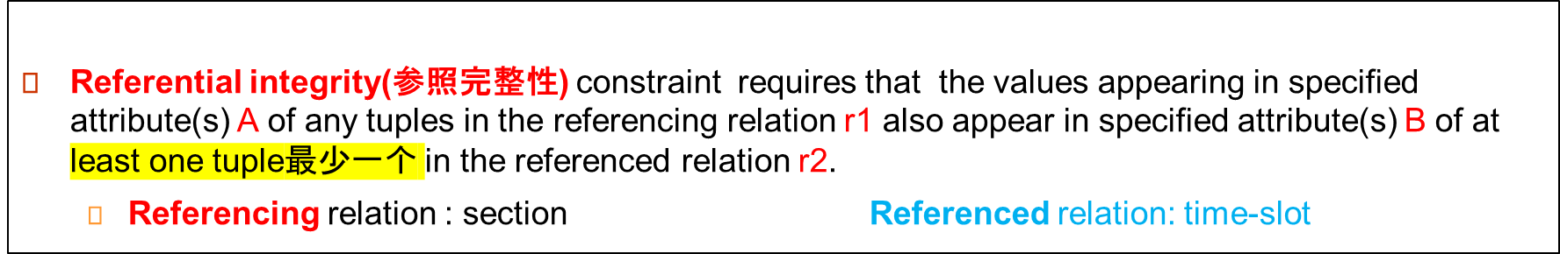

Keys
course_id
sec-id
semester
year
time-slot_id
time-slot_id
day
start-time
end-time
CS-101
CS-101
BIO-101
1
2
1
spring
spring
summer
2022
2022
2021
t1
t1
t2
t1
t1
t2
t2
Tue
Fri
Wed
Wed
13:15
8:00
13:15
18:30
15:40
9:35
15:40
20:05

Slide 8
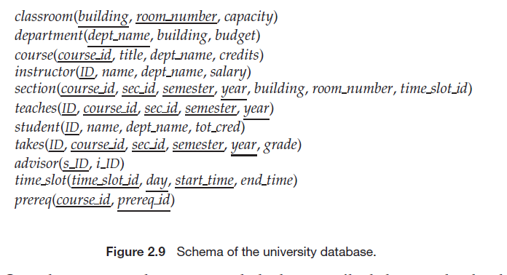
Database
下划线为prime key
A database consists of multiple relations
Information about an enterprise is broken up into parts
系名称
教学班
学生注册
课程预修关系

Slide 9

Schema Diagram 架构图for University Database
参照完整性
referential
Integrity constraint
是引用，但是不是time_slot 的prime
key
foreign-key constraint

Slide 10
Relational Query Languages
Procedural vs.non-procedural, or declarative
“Pure” languages:
  Relational algebra(关系代数) 用逻辑
  Tuple relational calculus（元组关系演算） 用运算符
  Domain relational calculus（域关系演算） 用运算符
3种等价
We will concentrate on relational algebra
  Not Turing-machine equivalent
  Consists of 6 basic operations

Slide 11
Relational Algebra关系代数
一种过程语言，由一组操作组成，这些操作以一个或两个关系作为输入，并产生一个新的关系作为结果
Six basic operators
  select: σ
  project: ∏
  union: ∪
  set difference: –
  Cartesian product(笛卡尔积): x
  rename: ρ
按条件选择元组
按条件选择列
关系相乘
交集，并不是基本运算，可以由集合运算表达出来 R-（R-S）

Slide 12

Select Operation
The select operation selects tuples that satisfy a given predicate.
Notation: σ _{p}(r)
p is called the selection predicate
Defined as:
σ_{p}(r) = {t | t ∈ r and p(t)}
Where p is a formula in propositional calculus consisting of terms connected by : ∧ (and), ∨ (or), ¬ (not)
Each term is one of:
<attribute> op <attribute>
<attribute> op <constant>
where op is one of: =, ≠, >, ≥. <. ≤
Example of selection:
σ _{dept_name=“Physics”}(instructor)
σ _{salary >} ₉₀₀₀₀ (instructor)
σ _{dept_name=“Physics” ∧ salary >} ₉₀₀₀₀ (instructor)
Relation r
σ_{A=B ^ D > 5} (r)
A等于B， 并且D大于5

Slide 13


Project Operation
Relation r:
The project operation is a unary operation that returns its argument relation, with certain attributes left out.
Notation:
where A₁, A₂ are attribute names and r is a relation name.
The result is defined as the relation of k columns obtained by erasing the columns that are not listed
Duplicate rows removed from result, since relations are sets
Example: To eliminate the dept_name attribute of instructor
∏_{ID, name, salary} (instructor)
∏_{A,C} (r)
集合没有重复元素

Slide 14

Union Operation 并
The union operation allows us to combine two relations
Notation: r ∪ s
Defined as:
r ∪ s = {t | t ∈ r or t ∈ s}
For r ∪ s to be valid.
1. r, s must have the same arity (元数) 属性数量相同
2. The attribute domains must be compatible (example: 2nd column
of r deals with the same type of values as does the 2nd
column of s)
Example: to find all courses taught in the Fall 2009 semester, or in the Spring 2010 semester, or in both
∏_{course_id} (σ _{semester=“Fall” Λ year=2009} (section)) ∪
∏_{course_id} (σ _{semester=“Spring” Λ year=2010} (section))
Relations r, s:
r ∪ s:

Slide 15

Set difference 差
The set-difference operation allows us to find tuples that are in one relation but are not in another.
Notation r – s
Defined as:
r – s = {t | t ∈ r and t ∉ s}
Set differences must be taken between compatible relations.
  r and s must have the same arity 属性数量相同
  attribute domains of r and s must be compatibler和s的属性域必须兼容
Example: to find all courses taught in the Fall 2009 semester, but not in the Spring 2010 semester
∏_{course_id} (σ _{semester=“Fall” Λ year=2009} (section)) −
∏_{course_id} (σ _{semester=“Spring” Λ year=2010} (section))
Relations r, s:
r – s:

Slide 16

Cartesian-Product Operation笛卡尔积
Relations r, s:
The Cartesian-product operation (denoted by X) allows us to combine information from any two relations.
Notation r x s
Defined as:
r x s = {t q | t ∈ r and q ∈ s}
Assume that attributes of r(R) and s(S) are disjoint. (That is, R ∩ S = ∅). 不相容
If attributes of r(R) and s(S) are not disjoint, then renaming must be used. 属性一样就改个名字
r x s:

Slide 17

Rename Operation
Allows us to name, and therefore to refer to, the results of relational-algebra expressions.
Allows us to refer to a relation by more than one name.
Example:
ρ _{x} (E)
returns the expression E under the name X
If a relational-algebra expression E has arity n, then
returns the result of expression E under the name X, and with the
attributes renamed to A₁ , A₂ , …., A_{n} . 每个属性都重新命名

Slide 18
Example Queries
Find the names of all instructors in the Physics department, along with the course_id of all courses they have taught
  Query 1
  ∏_{instructor.name,course_id} (σ_{dept_name=“Physics”} (
  σ _{instructor.ID=teaches.ID} (instructor x teaches)))
  Query 2
  ∏_{instructor.name,course_id} (σ_{instructor.ID=teaches.ID} (
  σ _{dept_name=“Physics”} (instructor) x teaches))
更高效（笛卡尔积算出来更小）

Slide 19
Example Queries
Find the names of all instructors in the Physics department, along with the course_id and title of all courses they have taught
  Query
  ∏instructor.name, course.course_id. course.title (σ_{dept_name=“Physics” Λ}
  instructor.ID=teaches.ID Λ teaches.course_id=course.course_id (instructor x
  teaches x course))

Slide 20
Example Query
Find the largest salary in the university
  Step 1: find instructor salaries that are less than some other instructor salary (i.e. not maximum)
      using a copy of instructor under a new name d
    ∏_{instructor.salary} (σ _{instructor.salary < d.salary}
    (instructor x ρ_{d} (instructor)))
  Step 2: Find the largest salary
    ∏_{salary} (instructor) – ∏_{instructor.salary} (σ _{instructor.salary < d,salary} (instructor x ρ_{d} (instructor)))
工资要两两比较，要先进行笛卡尔积

Slide 21
Example Query
Find the largest salary in the university
∏_{salary} (instructor) –
∏_{instructor.salary} (σ _{instructor.salary < d.salary}
(instructor x ρ_{d} (instructor)))
ID
salary
10101
12121
15151
70000
80000
90000
instrtuctor.ID
instructor.salary
d.ID
d.salary
10101
10101
10101
12121
12121
12121
15151
15151
15151
70000
70000
70000
80000
80000
80000
90000
90000
90000
10101
12121
15151
10101
12121
15151
10101
12121
15151
70000
80000
90000
70000
80000
90000
70000
80000
90000

Slide 22
Formal Definition
A basic expression in the relational algebra consists of either one of the following:
  A relation in the database
  A constant relation
Let E₁ and E₂ be relational-algebra expressions; the following are all relational-algebra expressions:
  E₁ ∪ E₂
  E₁ – E₂
  E₁ x E₂
  σ_{p} (E₁), P is a predicate on attributes in E₁
  ∏_{s}(E₁), S is a list consisting of some of the attributes in E₁
  ρ _{x} (E₁), x is the new name for the result of E₁

Slide 23
Additional Operations附带操作
没有增加关系表达式表达能力，但是更方便了
We define additional operations that do not add any power to the
relational algebra, but that simplify common queries.
Set intersection: r ∩ s
Natural join: r s 自然连接
Assignment: ←
Outer join : r s, r s, r s
Division Operator: r ÷ s
交

Slide 24

Set-Intersection Operation – Example
Relation r, s:
r ∩ s
The set-intersection operation allows us to find tuples that are in both the input relations.
Notation: r ∩ s
Defined as:
r ∩ s = { t | t ∈ r and t ∈ s }
Assume:
  r, s have the same arity
  attributes of r and s are compatible
Note: r ∩ s = r – (r – s)

Slide 25

Natural Join – Example
Notation: r s
Relations r, s:
Let r and s be relations on schemas R and S respectively.
Then, r s is a relation on schema R ∪ S obtained as follows:
  Consider each pair of tuples t_{r} from r and t_{s} from s.
  If t_{r} and t_{s} have the same value on each of the attributes in R ∩ S, add a tuple t to the result, where
    t has the same value as t_{r} on r
    t has the same value as t_{s} on s
Example:
  R = (A, B, C, D)
  S = (E, B, D)
  Result schema = (A, B, C, D, E)
  r s =
  ∏_{r.A, r.B, r.C, r.D, s.E} (σ_{r.B = s.B ∧ r.D = s.D} (r x s))
自然连接则是在等值连接 (以公共属性值相等为条件)的基础上再行投影操作，去掉 S 中的公共属性列，当两个关系没有公共属性时，自然连接就转化成笛卡尔积
r s

Slide 26
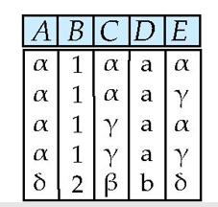
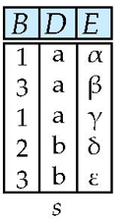

Slide 27
Natural Join and Theta Join条件连接
Find the names of all instructors in the Comp. Sci. department together with the course titles of all the courses that the instructors teach
  ∏ _{name, title} (σ _{dept_name=“Comp. Sci.”} (instructor teaches course))
Natural join is associative
  (instructor teaches) course is equivalent to
  instructor (teaches course)
Natural join is commutative
  instructor teaches is equivalent to
  teaches instructor
The theta join operation r _{θ} s is defined as
  r _{θ} s = σ_{θ} (r x s)

Slide 28

Outer Join外部连接
join重写
An extension of the join operation that avoids loss of information.
Computes the join and then adds tuples form one relation that does not match tuples in the other relation to the result of the join.
Uses null values:
  null signifies that the value is unknown or does not exist
  All comparisons involving null are (roughly speaking) false by definition.
    We shall study precise meaning of comparisons with nulls later
Outer join can be expressed using basic operations
  r s can be written as
  (r s) U (r – ∏_{R}(r s) x {(null, …, null)}
  r s can be written as
  (r s) U {(null, …, null)} x (s – ∏_{s}(r s)
  r s can be written as
  (r s) U
  (r – ∏_{R}(r s) x {(null, …, null)} U
  {(null, …, null)} x (s – ∏_{s}(r s)

Slide 29
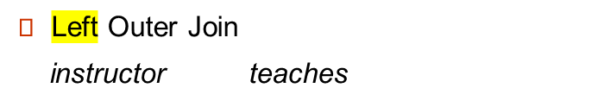

Outer Join – Example
instructor teaches
ID
name
dept_name
ID
course_id
10101
12121
15151
Srinivasan
Wu
Mozart
Comp. Sci.
Finance
Music
10101
12121
76766
CS-101
FIN-201
BIO-101
Join
instructor teaches
ID
name
dept_name
course_id
10101
12121
Srinivasan
Wu
Comp. Sci.
Finance
CS-101
FIN-201
ID
name
dept_name
course_id
10101
12121
15151
Srinivasan
Wu
Mozart
Comp. Sci.
Finance
Music
CS-101
FIN-201
null

Slide 30


接上例
Right Outer Join
instructor teaches
ID
name
dept_name
course_id
10101
12121
76766
Srinivasan
Wu
null
Comp. Sci.
Finance
null
CS-101
FIN-201
BIO-101
Full Outer Join
instructor teaches
ID
name
dept_name
course_id
10101
12121
15151
76766
Srinivasan
Wu
Mozart
null
Comp. Sci.
Finance
Music
null
CS-101
FIN-201
null
BIO-101

Slide 31
Assignment Operation赋值
The assignment operation (←) provides a convenient way to express complex queries.
  Write query as a sequential program consisting of
    a series of assignments
    followed by an expression whose value is displayed as a result of the query.
  Assignment must always be made to a temporary relation variable.

Slide 32
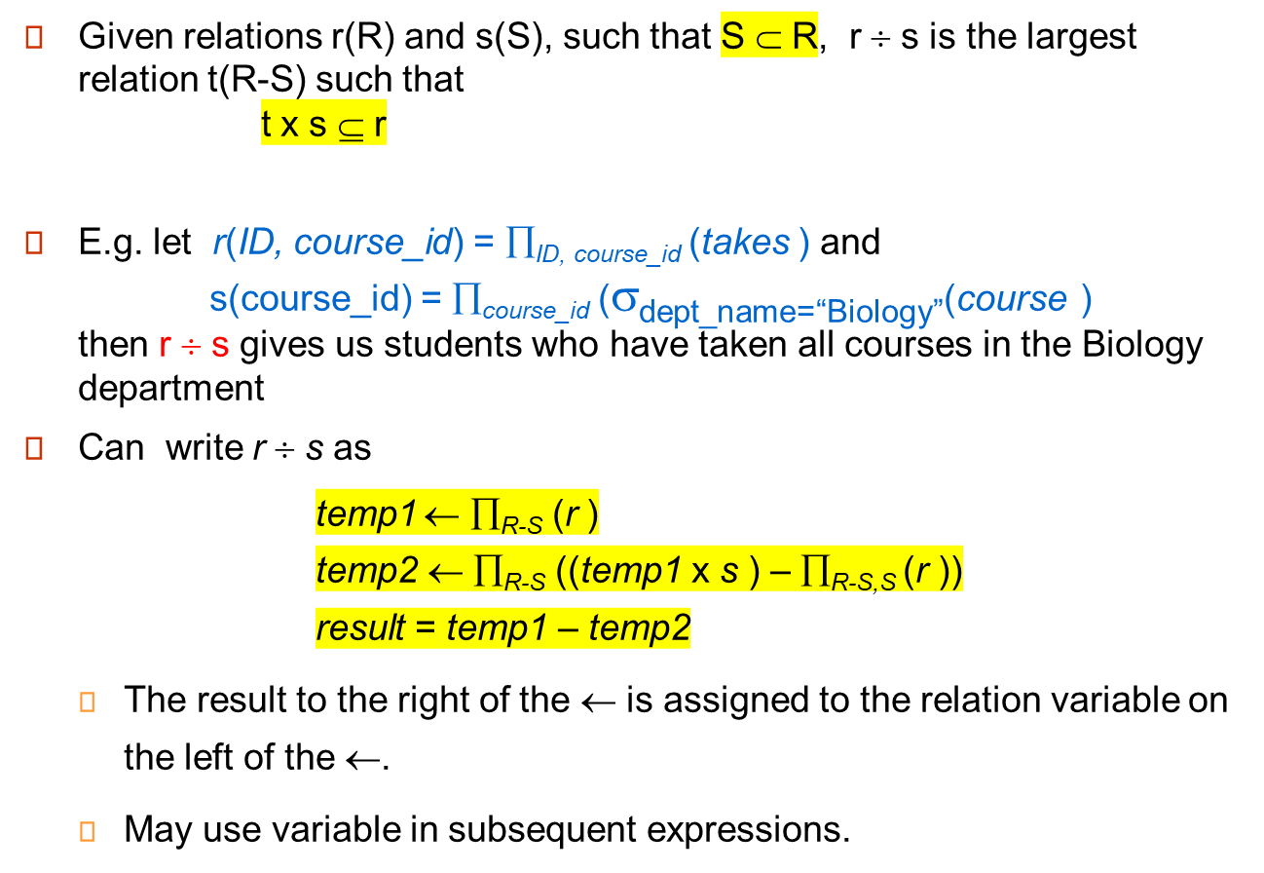
Division Operator 除法
R,S全部乘起来

Slide 33
Division Example1
Relations r, s:
A
B
B
r ÷ s:
α
α
α
β
γ
δ
δ
δ
∈
∈
β
1
2
3
1
1
1
3
4
6
1
2
1
2
A
s
α
β
B是AB子集的A
r

Slide 34
Division Example 2
Relations r, s:
A
B
C
D
E
D
E
α
α
α
β
β
γ
γ
γ
a
a
a
a
a
a
a
a
α
γ
γ
γ
γ
γ
γ
β
a
a
b
a
b
a
b
b
1
1
1
1
3
1
1
1
a
b
1
1
s
r
r ÷ s:
A
B
C
α
γ
a
a
γ
γ

Slide 35
Extended Relational-Algebra-Operations
Generalized Projection 泛化属性
Aggregate Functions
比如，分组统计的功能，6个基本函数无法表达
以上两个函数增加了关系函数的表达能力

Slide 36

Generalized Projection
Extends the projection operation by allowing arithmetic functions to be used in the projection list.
E is any relational-algebra expression
Each of F₁, F₂, …, F_{n} are are arithmetic expression算术表达式 involving constants and attributes in the schema of E.
Given relation instructor(ID, name, dept_name, salary) where salary is annual salary, get the same information but with monthly salary
∏_{ID, name, dept_name, salary/12} (instructor)

Slide 37


Aggregate Functions and Operations
Aggregation function （聚合函数）takes a collection of values and returns a single value as a result.
avg: average value
min: minimum value
max: maximum value
sum: sum of values
count: number of values 值的个数
Aggregate operation in relational algebra
E is any relational-algebra expression
  G₁, G₂ …, G_{n} is a list of attributes on which to group (can be empty) 前面这些为分组属性
  Each F_{i} is an aggregate function
  Each A_{i} is an attribute name
Note: Some books/articles use γ instead of (Calligraphic G)

Slide 38
Aggregate Example1
Relation r:
A
B
C
α
α
β
β
α
β
β
β
7
7
3
10
_{sum(c)} (r)
sum(c )
27

Slide 39

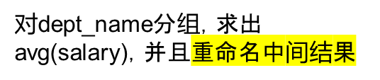

Aggregate Example2
Find the average salary in each department
_{dept_name} _{avg(salary)} (instructor)
每个salary有几个人
_{salary count(*)} (instructor)
avg_salary

Slide 40
Aggregate Functions (Cont.)
Result of aggregation does not have a name
  Can use rename operation to give it a name
  For convenience, we permit renaming as part of aggregate operation
_{dept_name} _{avg(salary) as avg_sal} (instructor)

Slide 41
Modification of the Database
The content of the database may be modified using the following operations:
  Deletion
  Insertion
  Updating
All these operations can be expressed using the assignment operator

Slide 42
Multiset Relational Algebra
Pure relational algebra removes all duplicates
  e.g. after projection
Multiset（多重集） 有重合relational algebra retains duplicates, to match SQL semantics
  SQL duplicate retention was initially for efficiency, but is now a feature
Multiset relational algebra defined as follows
  selection: has as many duplicates of a tuple as in the input, if the tuple satisfies the selection
  projection: one tuple per input tuple, even if it is a duplicate
  cross product: If there are m copies of t1 in r, and n copies of t2 in s, there are m x n copies of t1.t2 in r x s
  set operators
    union: m + n copies
    intersection: min(m, n) copies
    difference: min(0, m – n) copies
保留重合的元组（因为去重的代价很大）
理解传统的关系代数就好啦

Slide 43
SQL and Relational Algebra
select A1, A2, .. An
from r1, r2, …, rm
where P
is equivalent to the following expression in multiset relational algebra
∏ _{A1, .., An} (σ _{P} (r1 x r2 x .. x rm) )
select A1, A2, sum(A3)
from r1, r2, …, rm
where P
group by A1, A2
is equivalent to the following expression in multiset relational algebra
_{A1, A2} _{sum(A3)} (σ _{P} (r1 x r2 x .. x rm)))

Slide 44
SQL and Relational Algebra
More generally, the non-aggregated attributes in the select clause may be a subset of the group by attributes, in which case the equivalence is as follows:
select A1, sum(A3)
from r1, r2, …, rm
where P
group by A1, A2
is equivalent to the following expression in multiset relational algebra
∏ _{A1,sumA3}( _{A1,A2} _{sum(A3)} _{as sumA3}(σ _{P} (r1 x r2 x .. x rm)))

